Slide 1
Transformation Workstreams

Slide 2

Transformation Key Elements
Organizational Change Management
Collaborative Culture
Transformation Plan
Team Enablement
Invest in Engineering Practices and Infrastructure
A
B
Stakeholder Awareness Programs
Train from Top Down
Outsourcing Strategy
C
Be Willing to Change
Support to Middle Management
Engage & Commit Business Partners
D
People
Process and SDLC Tools
A
Set up new DevOps Roles
People Culture
B
Self Motivated
Cross Functional Team
Standardization
Continuous Improvements
D
Lean Automated Machine First Approach
Executive Coaching
Team Coaching & Mentoring
Best Practices
Metrics and Measurements
Team Organization
Motivation & Empowerment
Automated Process Life Cycle
Quality Engineering
Governance
Resource Management
Governance Model
Competency Management
Self Governance
Communication Model
Team Structure
Roles & Responsibility
Delivery Model

Slide 3
Transformation Workstreams
Operating Model Key Dimensions
Organization
Culture
Workplace
Reimagination
Workforce
Transformation
IT Vision, Cloud Roadmap
Tools Automation
Establish Transformation Culture, policy and approach
Aligning the sponsors, Business, Dev/QE/Operations teams
Key transformational role such as Transformational office, Agents, Devops Roles, Agile Roles, Automation Roles
Collaborated Digital Agile Workspace environment
Innovation and Idea generation at team member level.
Rewards and Recognition at team levels
Quicker decision making process and localized empowerment
Focused training on Methodology/new technology/ platforms/Automation tools
Facilitate adaption of Agile and DevOps through corporate team engagement programs
Tools and Programming practices aligned to Future IT
Cloud Footprint and Architecture Vision
IT Sourcing Strategy
Tools Innovation based on Technology Landscape
Automation and cost optimization
DevOps
Delivery Model
Change
Management
Governance and Metrics
Relentless Improvement
Continuous Integration & Delivery in Distributed Agile Environment using tool based Devops pipelines.
Run time code based Infrastructure
Continuous Testing and Feedback
Continuous Monitoring
ROI Driven Value Stream Mapping
Industry leading maturity roadmap pertaining to People, Process and Technology
KPI Benchmarking and Trending
Continuous Learning and Career guidance by mentor’s aligned to organization goal
Change Management Framework using Agile Best Practices
Business participation in prioritization of backlog
Change Management at the rate of Business demand
Establish Metrics Framework
Baseline LoB specific Metrics
Foster Insight Driven DevOps Maturity Roadmap
Govern Stability of Production environment

Slide 4

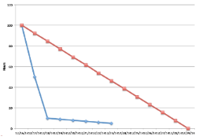

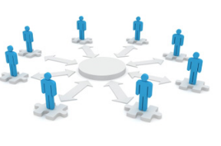



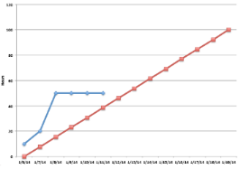
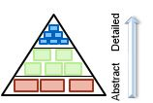
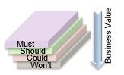

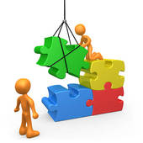
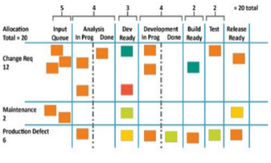
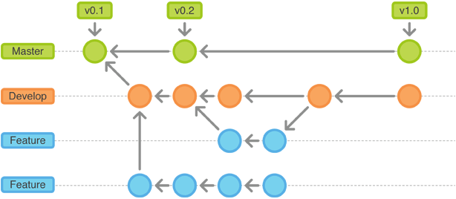
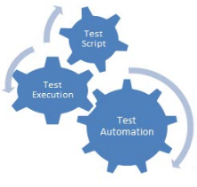


Agile Team Structure
Scrum Master
Impediments Tracking & Resolution Management
Iteration Progress
Tracking & Reporting
Craft Success Stories & Generate Short Term Wins
Enabling Self Organizing & Self Managing Culture in Team
Focus on Team Continuous Improvement & Planning
Product Owner
Feature Planning
Feature & Release Progress Tracking & Reporting
Product Backlog –
Progressive Elaboration
Product Backlog –
Continuous Prioritization
User Story Scoping & Refinement
Agile Team
Design, Build & Test
Iteration Backlog Management
Continuous Integration
& Deployment
Functional & Regression
Test Automation
Competency Building & Scaling

Slide 5


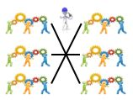

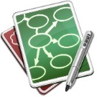
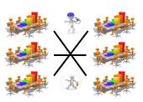




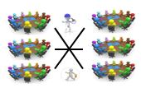

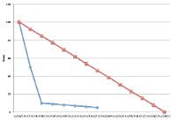
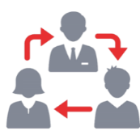


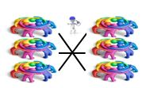

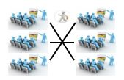

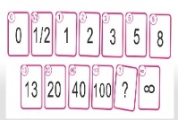

Agile Way of Working – Team Operating Model and Activities
Iteration Activities – Scrum Team
Multi-Team Scrum
Sprint Planning
Chief Scrum Master
Daily Standup
Backlog Refinement
Retrospective of
Retrospectives
Release Planning &
Epics Breakdown
Iteration Retrospective
Test Plan Review
Iteration Review
Chief Product Owner
BA
Scrum Master
QA
Dev
Sprint Planning &
Synchronization
Join Application
Design
Enterprise Architecture Team
Iteration Progress Updates & Review
Pairing
Poly Skill Modeling
Product Owner
Agile Leaders
Story Estimation
Impediments Resolution & Defect Triage
Business Ops & Agile Team Collaboration
Integrated
System Demo
Scrum of Scrums

Slide 6
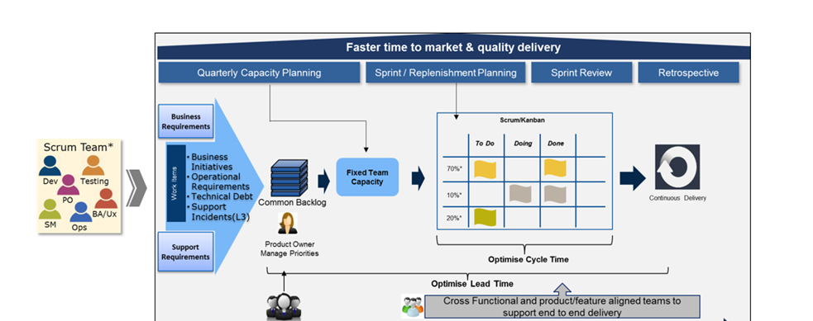
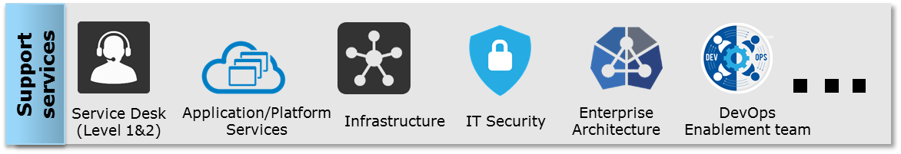
DevopsTeam Delivery Model (Agile / Devops)
Continuous Deployment
Business Sponsor/User
Support needs
Self-service Infrastructure/ Platform
Infrastructure/ Platform Availability
Infrastructure/ Platform needs
Common Services
Continuous Flow

Slide 7







Distributed Agile Framework (Operating Model)
Program & release train
Solution Architect
Domain Engineer
Test Engineer
Security Architect
Program Manager
Release Train Engineer
Feature team 1
Feature team 2
Feature team 3
0
Team 1
Team 2
Product Owner
Product Owner
Product Owner
18
6
Team
Members
Scrum Master
12
Collaboration Network
Daily
Standup
Video
Sprint
Planning
Sprint
Demo
Weekly
Status
0
Scrum Master
Scrum Maser
18
6
Team Members
Team Members
Team Members
ADM
12
TCS

Slide 8
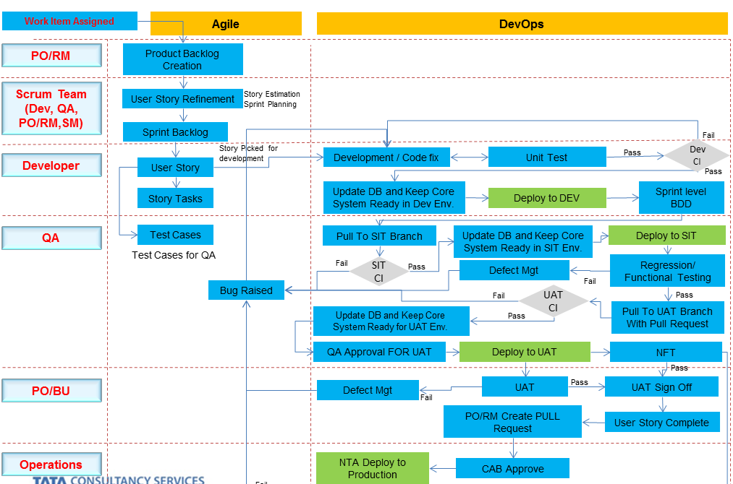
Agile DevOps Workflow

Slide 9
High Level Visualization of Roles / Skillsets/Teams
Executive Sponsor (Steering Committee)
Transformation Center
Organization Change Management
COE Services
(Benchmarks & Standardization)
Common Services
Program Management
Roles
Agile Practioner/Scrum Master
Agile Coach
Devops Architect
Devops Engineer
Cloud Platform Architect(Infra)
Solution Architect
Business Process Owner
Technical Developer
Tester/Assurance Engineer
Security Consultant
Helpdesk personnel
Transformation Manager
Delivery Manager
Vendor & Customer Service Management
Marketing & Communication
Domain Expert
Architecture
Cloud Expert
Sourcing
Legal
Scrum Master
Release Mgr (Scrum of Scrums)
HR ( Team Events, Team Goals, Team G
Rewards,)
Technology Expert
Microservices Expert
IntegrationsExpert
Finance
Transition Manager
Product Owners
Devops Expert
Security Expert
Scrum Masters
Administration (Workplace Transformation)
Innovation / Research
Resource Acquisition
Service Procurement
Application Manager (Program, Portfolio)
Implementation
Operations
Cost Control
Strategic Alliance
Service Delivery
Trainers / Facilitators/ Change Agents
Devops
Product Teams
Shared Service
Assurance Service
Customer Profiling
Account Management
Workforce
Workplace
Product Team 1
Product Team 2
Product Team 3
Product Team n
Infrastructure Service
Database Service
…….
Service Management
Cultural Change
Role Mapping
Agile Leaders
Change Management
Satisfaction Index Management
Work Area
Roles/ Skillsets
Authentication/ Authorization
Security
Audit & Compliance
Service Desk
Event Management
System Logs
Caching
Monitoring
Notifications
Data Services
Services
Common Services

Slide 10
Product Team Structure
Common Services
Authentication/ Authorization
Security
Audit & Compliance
Service Desk
Event Management
System Logs
Caching
Monitoring
Scrum Teams
Scrum Team
Product Owner
Support Enginner
Coe Core Team
Si Augumented Flexi Team
Infrastructure Enginner
Developers
Testers
Release Engineer
Integration Architect
Reliability Engineering

Slide 11
CLOUD PLATFORM SERVICES-DETAILED
Business Services
Cloud Services
Transformation Centre
IaaS
PaaS
IT Operations
Service Provider Relationship Management
CSP Relationship Management
FaaS
iPaaS
Enterprise IT (Applications & Services)
Corporate IT (Applications & Services)
Group Unit Wide Capabilities (Security, Governance, Infrastructure Operations, ITSM, Developers. Architects, QA)
Cloud Centre of Excellence (CCoE)
SaaS
Application Development
Cloud Brokerage
Cloud Governance
Cloud Approval Board
Cloud Office
Application Integration
TCS Proposed Cloud Operating Model (New Common functions)
Cloud Infrastructure & Platform Support Services
Cloud Application Services
Cloud Advisory Council
Application Operations
Network Monitoring & Management
Database & Middleware Management
Application Development
Cloud Standards
Infrastructure Operations
Application Operations
Patch Management
Cloud Infrastructure Life Cycle Management
Quality Assurance
Cloud Policies
Data Centre Operations
DevOps
Platform Management for Multi clouds
Monitoring & Reporting
Data Management
Cloud Procedures
IT Service Management
API Management
CSP SLA Management
Security Monitoring & Operations
Application & Data Security
Training & Skill set Acquisition
CI CD Pipeline Management
Cloud Accounts & Subscription Mgmt.
Configuration Automation
Release Automation
Cloud Service Management
DR Management
Service Desk
Capacity Management
Incident Management
Change Management
Compliance Management
Cloud Resource & Cost Optimization
Performance Management
Change Management
Cloud Cost Control Services
Self Service Portal
Cloud Service Catalog Management
Cost Allocation & Resource Tagging
Incident Management
Metering & Budgeting
Identity Access Management
Backup & Recovery Management
Charge Back / Show Back
Service Desk

Slide 12
High Level Visualization of Activities
Governance| Overview of Services
Integrated Transformation Management Office
Stakeholder Management
Program Strategy
Benefit planning & strategy
Risk Assessment
Program Roadmap
Governance Strategy
Implementation plan
Transition & acceptance plan
Communication plan
Scrum Management
Demand management & Prioritization
Facilitate Team Participation, Team Enablement & Coaching
Work towards removing impediments
Inter-program Cadence
Service Delivery Management
Vendor Service Integration
SLA & Metrics
Showback & Chargeback
Foundation Service Management
Shared Service Management
Cloud Management & Brokering
Integration Service
Microservice Line of Business
Agile & Devops Service Line
Assurance Service
Data Service Management
Innovation / Automation / AI
Transformation / Mogration Service Line
Transition Services
Change management Services
CoE Services
Architecture Review Board
Enforcement of standards & best practices
Establishing Global Process Templates
Drift Management
Technology Avenglist
Innovation & ideation
Organization Change Management
Benefits Realization
Change Strategy
Leadership Alignment
Stakeholder Mgt
Role Impact Analysis
Change Network & Agile Teams
Communications
Workforce Optimization
Training Need Analysis & Strategy
Integrated Holistic, Proactive Oversight of the transformation journey and its complex portfolio of initiatives

Slide 13
ADM Cloud Native Application Support – RACI (COE Services)
Task | Responsible | Accountable | Consulted | Informed
COE Services
Business Process Benchmark (Global Templates, Process Lean, Standardization, Governance) | Business Process Owner | Business Process Owner | Doman Expert | Transformation Mgr
Establish the Cloud Foundation architecture ( Authentication, Security, Network, resource provisioning & allocation, service governance) etc | Cloud Expert | Enterprise Architect | Solution Architect | Transformation Mgr
Establish the Devops reference framework for ADM | Devops Architect | Enterprise Architect | Solution Architect | Transformation Mgr
Finalize Architecture Considerations for cloud native development with technology guidelines | Solution Architect | Enterprise Architect | Cloud Expert | Transformation Mgr
Approve Application architectures and technology choices | Solution Architect | Enterprise Architect | Cloud Expert | Transformation Mgr
Identify opportunities for Automation | Enterprise Architect | Enterprise Architect Assurance Manager | Solution Architect Cloud Expert | Transformation Mgr
Drive towards Self Service Provisioning, Orchestration & Tagging Model without compromising on cost accountability | Enterprise Architect | Enterprise Architect | Solution Architect Cloud Expert | Transformation Mgr
Establish Service Monitoring framework (Infra & Application) with BCP, DR strategy etc | Enterprise Architect | Enterprise Architect | Solution Architect Cloud Expert | Transformation Mgr
Agile Delivery Facilitation & Management | Agile Coach | Scrum Master | Solution Architect Delivery Manager | Transformation Manager

Slide 14
ADM Cloud Native Application Support – RACI (Common Services)
Task | Responsible | Accountable | Consulted | Informed
Common Services - Security
Configuration ,Testing and Support of Virtual Firewall, Network Boundary Protection, Endpoint Security etc | Infrastructure Consultant | Infrastructure Consultant | Solution Architect (Infra) | Delivery Manager
Configure Encryption, Key Management and Certificates | Infrastructure Consultant | Infrastructure Consultant | Solution Architect (Infra) | Delivery Manager
Identity and Access Management , configure Authentication and Authorization | Infrastructure Consultant | Infrastructure Consultant | Solution Architect (Infra) | Delivery Manager
Configure Security & Compliance encompassing areas like Security Monitoring, Threat Monitoring, Governance& Risk Management, Security Incident Response | Infrastructure Consultant | Infrastructure Consultant | Solution Architect (Infra) Cloud Expert Enterprise Architect | Delivery Manager
Common Services – Backup
Configure backup of Azure resources | Infrastructure Consultant | Infrastructure Consultant | Solution Architect (Infra) | Delivery Manager
Common Services – Log
Configure Audit Log Management - Azure Audit logging using OMS. Consolidation & Storage of logs into Blob | Infrastructure Consultant | Infrastructure Consultant | Solution Architect (Infra) | Delivery Manager

Slide 15
ADM Cloud Native Application Support – RACI (Operations - Devops)
Task | Responsible | Accountable | Consulted | Informed
Operations - Devops
Configure Platform/OS Monitoring & Alerting
Configure Azure Solarwinds / Network Watcher for Network Monitoring
Perform patch management
Configure Azure application Insights and monitoring parameters

Slide 16
ADM Cloud Native Application Support – RACI (Development Services)
Task | Responsible | Accountable | Consulted | Informed
Development Services
Application Developmment & Testing aligned with COE policies on Archutecture, Tools, Standards | Technical Developer | Technical Developer | Solution Architect | Scrum Master
Test Automation activities as identified in the Product Backlog | Assurance Engineer | Assurance Engineer | Business Process Owner | Scrum Master
Implement the identified Devops Platform requirements and estalish a CI/CD framework | Technical Developer | Technical Developer | Devops Engineer | Scrum Master
Achieve the Sprint Goals in Development. Testing, and Operation workareas | Technical Developer | Scrum Master | Business Process Owner | BPO Delivery Manager
Enable and Adopt Self Service model in work activities | Scrum Master | Scrum Master | Business Process Owner | BPO Delivery Manager
Implement the Backup and Recovery services as per the solution blueprint | Technical Developer | Cloud Platform Architect(Infra) | Cloud Platform Architect(Infra) | Scrum Master Delivery Manager
Development – Integration Services
Manage iPaaS – Cloud Integration | Technical Developer | Scrum Master | Solution Architect Cloud Expert | Delivery Manager

Slide 17
ADM Cloud Native Application Support – RACI (Program Management)
Task | Responsible | Accountable | Consulted | Informed
Program Management
Facilitate Sprint Progress & Agile Delivery | Scrum Master | Scrum Master | Agile Leaders | Transformation Mgr
Establish Cadence between Sprint Teams | Release Train Engineer | Release Train Engineer | Scrum Master | Transformation Mgr
Ensure Service Level of the applications at the portfolio level | Application Manager (Portfolio) | Application Manager (Portfolio) | Transformation Mgr | Transition Mgr
Ensure Delivery of required services (Integration, Devops, Infrastructure, Operational Support) | Application Manager (Portfolio) | Service Delivery Manager | Transformation Mgr | Transition Mgr
Work Prioritization & managing of the service delivery queue for Shared Service | Service Delivery Manager | Service Delivery Manager | Application Manager (Portfolio) | Application Mgr(Portfolio)
Task
Task

Slide 18
CLOUD GOVERNANCE - BUILDING BLOCKS and Principles
Cloud Governance Principles
☑ Responsibility ☑ Stakeholder Involvement ☑ Transparency ☑ Compliance ☑ Performance ☑ Alignment ☑ Risk Optimization ☑ Sustainability
Cloud Governance System
Strategic Alignment Framework
Decision Framework
Integrated Cloud Governance and Management
Structure, Roles & Responsibility
Governance Process and Measures
Policies, Procedures, Plans and Objectives
Communication and Collaboration
Cloud Service Management
Cloud Service Management System

Slide 19
FRAMEWORK FOR STRATEGY & GOVERNANCE
Cloud Business Strategy
Cloud IT Strategy & App/Infra services
Business Case
Business Strategy
Compliance & Risk
Business OLA’s / SLA’s
Cloud Arch
Application Assessment
Decision tree & Est Model
Arch(Security, Integration Network… )
Workforce Re-skilling
Cloud Competency Centre(CoE)
Cloud Strategy Team
Cloud Cockpit
Azure Architecture Enablement Team
Azure Platform Support Team (Devops)
Cloud Governance Services
Extended Team
Scrum Teams
Extended Team
Scrum Teams
TOM
Planning & dependency
Cloud Adoption Governance
Reporting & Change Management
Cloud Platform Support Services
DevOps
Cloud Optimization
Cloud Management
Service Management

Slide 20
Target Operating Model View
ADM Value Streams (Process Areas)
Vendor Service Integration (Vendor Management)
Transformation Center & OCM
COE Center (Benchmarks & Standardization)
Target Operating Model
Value Management Office
Business Value Management
Agile DevOps & Automation
Development & Testing
Experience Layer
Operations
Digital Experience Layer
API Services Layer (API Gateway)
Integration Layer
Legend:
Channel Service Layer
Business Services Layer
Service Desk
Work Stream
Micro-service
FaaS
Application Components
Business Process
Reliability Engineering Team
(Server, Storage, Backup, Network, Security, Database, Middleware)
Integration Layer
Integration Layer
E2E Governance
Integration Components
Domain Service Layer
Common Service Components
DMS/CMS
Database
Application
Caching & CDN
Value Stream
IaaS & Cloud Native Services (PaaS )
B2B Integration
Event Hub
Service Bus
Message Queues
Social
Integrations
SaaS
External Applications
ADM Data Center
Common Service
Event Management
System Logs
Caching
Monitoring
Notifications
Security
IAM
SSO
App Security
Data Security
Audit & Compliance
Cloud Security

